Slide 1




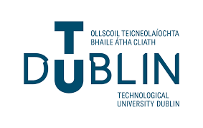
A-EYE Control Tower: AI-driven visibility platform to improve productivity on construction sites
A-EYE Technology
Visualisation Platform for Improving
Construction Productivity

Slide 2
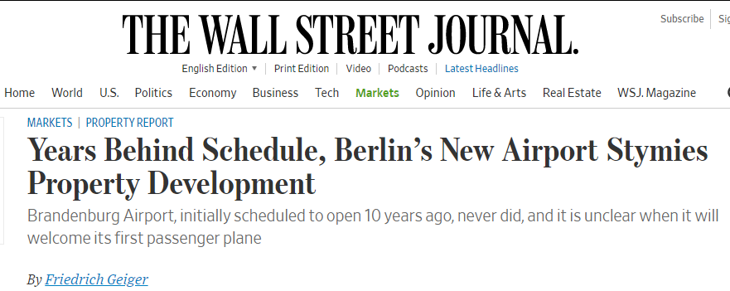
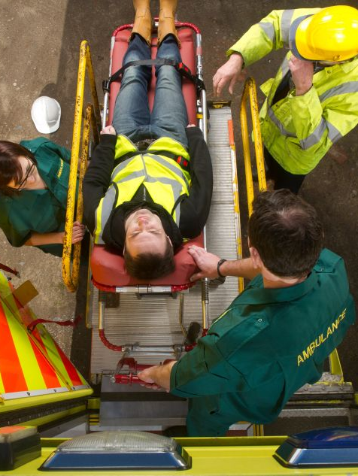
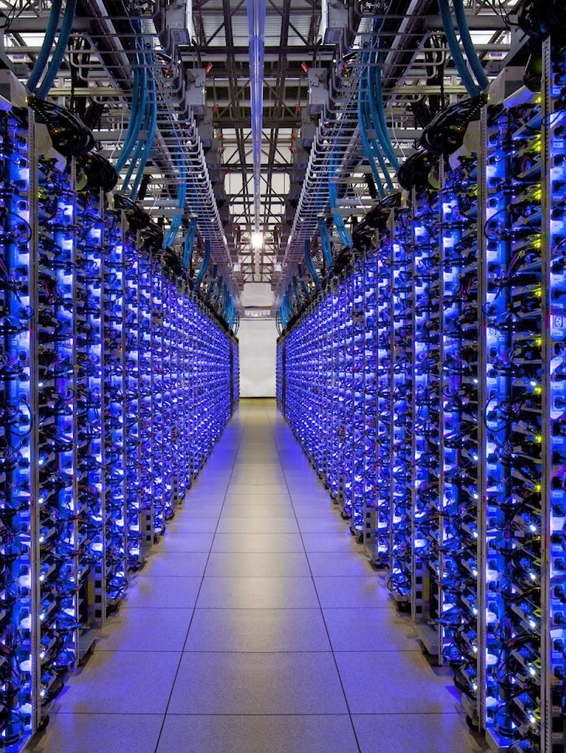

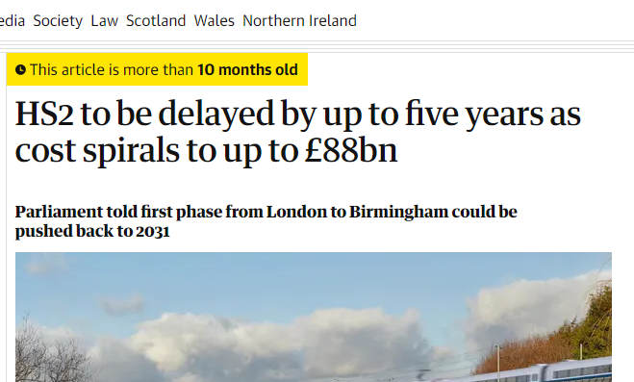
A-EYE Control Tower: AI-driven visibility platform to improve productivity on construction sites
Cost Overruns and Delays
Unexpected Accidents and Events
Unutilised Accumulated Data

Slide 3
A-EYE Control Tower: AI-driven visibility platform to improve productivity on construction sites
PROBLEM
SOLUTION
Modest Construction Productivity
A-Eye platform to coordinate and monitor the construction process
Industry Fragmentation
Limited Off-site Production
Poor Investment in Technology
The Complexity of Measuring Construction Productivity

Slide 4
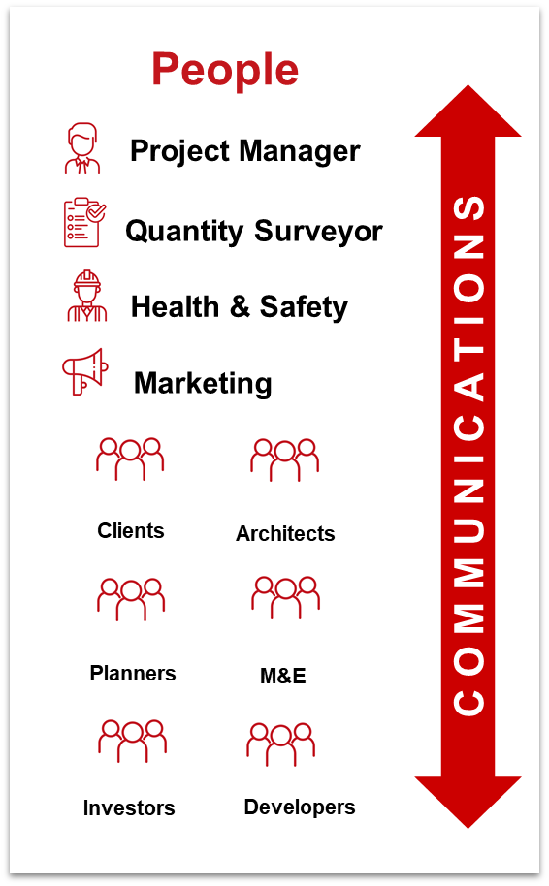
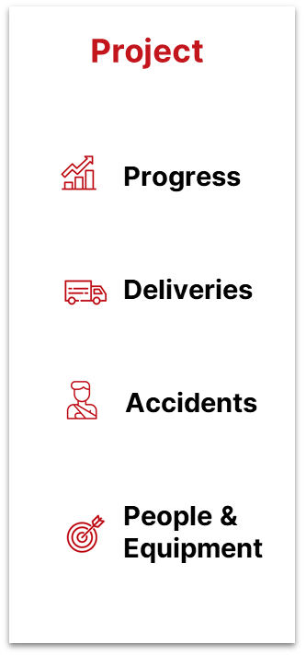
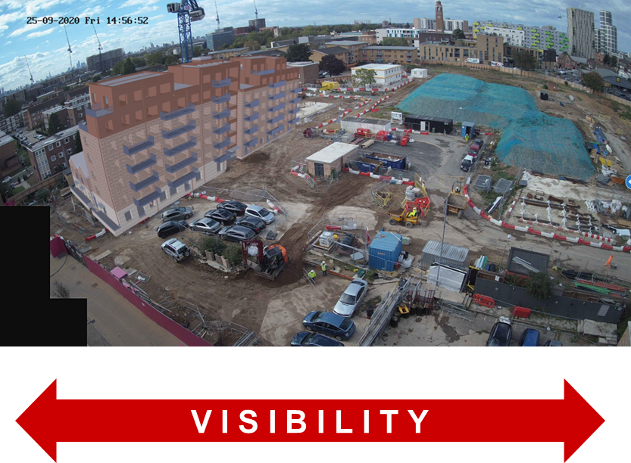
A-EYE Control Tower: AI-driven visibility platform to improve productivity on construction sites
Solution

Slide 5
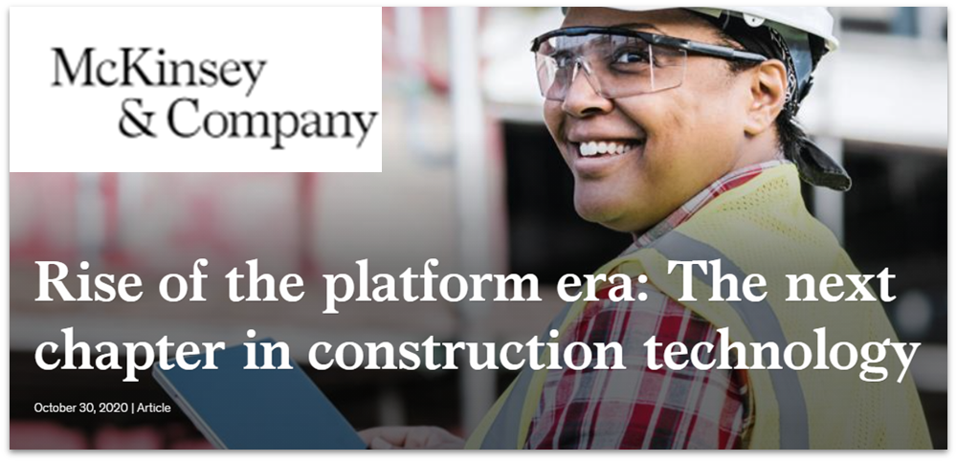
A-EYE Control Tower: AI-driven visibility platform to improve productivity on construction sites
“The construction technology ecosystem is shifting toward integrated software platforms that better serve customer needs. Significant opportunities exist for strategic and financial investors.” – McKinsey & Co. (2020)

Slide 6
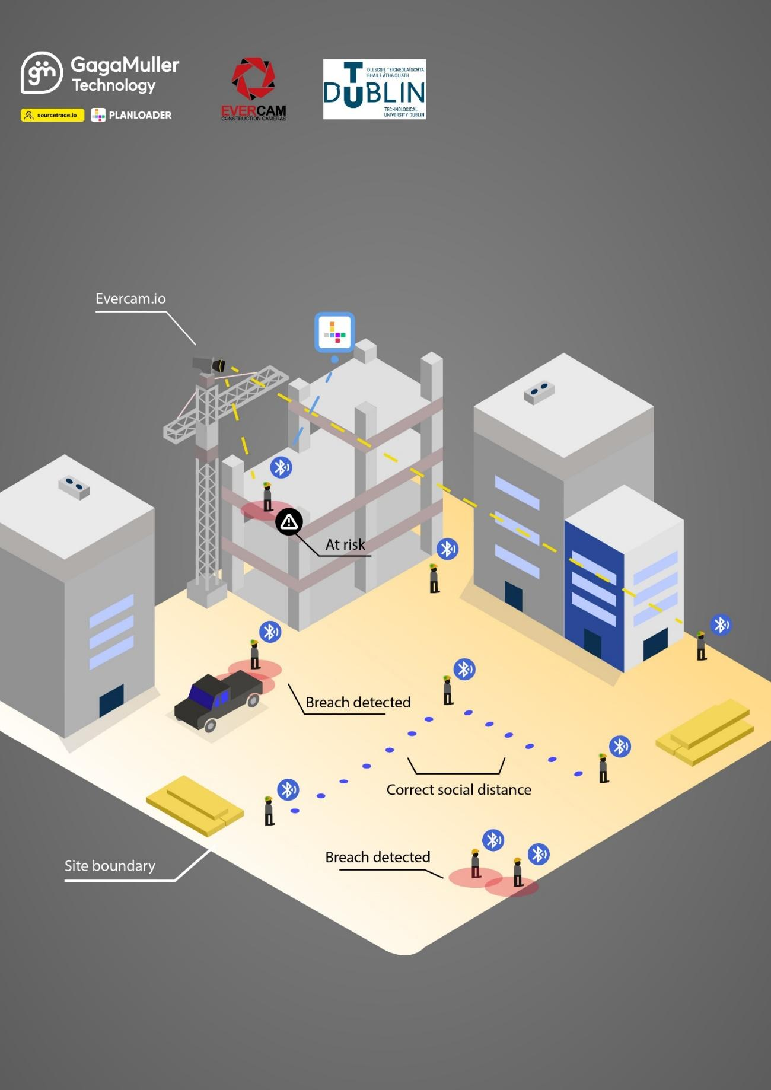
A-EYE Control Tower: AI-driven visibility platform to improve productivity on construction sites
A-EYE IN A SNAPSHOT
Real-time Scheduling and BIM Model Update.
Matching Billing Process with On-site Progress.
Real-time Alerts to Prevent Safety Hazards.
Precise Performance Analytics and Productivity Benchmarking.

Slide 7

A-EYE Control Tower: AI-driven visibility platform to improve productivity on construction sites

Slide 8

A-EYE Control Tower: AI-driven visibility platform to improve productivity on construction sites

Slide 9
A-EYE Control Tower: AI-driven visibility platform to improve productivity on construction sites
Project Partners
Construction Visualisation Experts
GagaMuller Group
Innovate – Disrupt – Integrate
Technological
University Dublin
Leader in Computer Vision & AI
100% y/y growth over 4 years
800 projects in 10 Countries
100+ employees in 13 Countries
Project Mgt. & Geospatial Surveying
Data Analytics & Custom Apps
60+ projects in 9 Countries
50+ employees in 4 Countries
Ireland’s 1st Technological University.
7500+ AEC Students & Researchers.
Team of reputable researchers
in Construction Innovation.

Slide 10
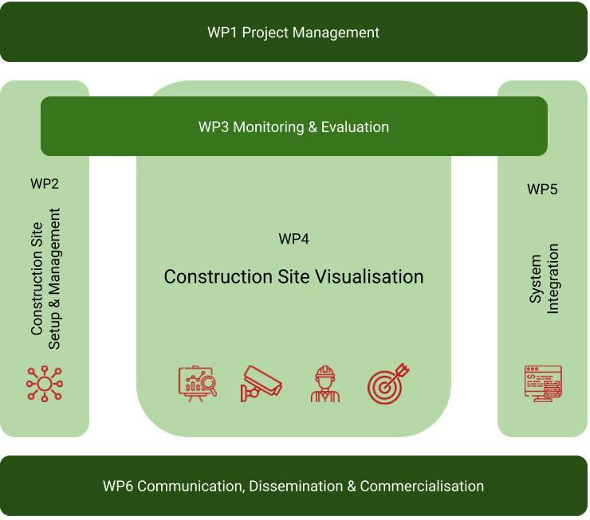
A-EYE Control Tower: AI-driven visibility platform to improve productivity on construction sites
Project Plan
Project Details
Project Duration: 3 years.
Commencement date: 1.12.2021
Budget: €3.78 million
Enterprise Ireland (DTIF) Contribution: €2.09 million
Practical Approach
Piloting on live construction site(s).

Slide 11
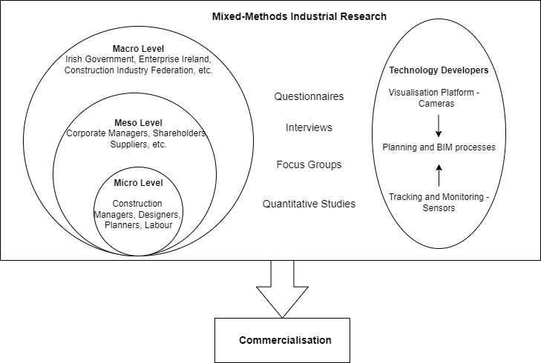
A-EYE Control Tower: AI-driven visibility platform to improve productivity on construction sites
Industrial Research Framework
Perceived Advantages: Productivity, Sustainability, and Communication benefits.
Challenges: Cultural issues, Skills shortage, Ethics, Costs, Security, Internet connectivity.

Slide 12
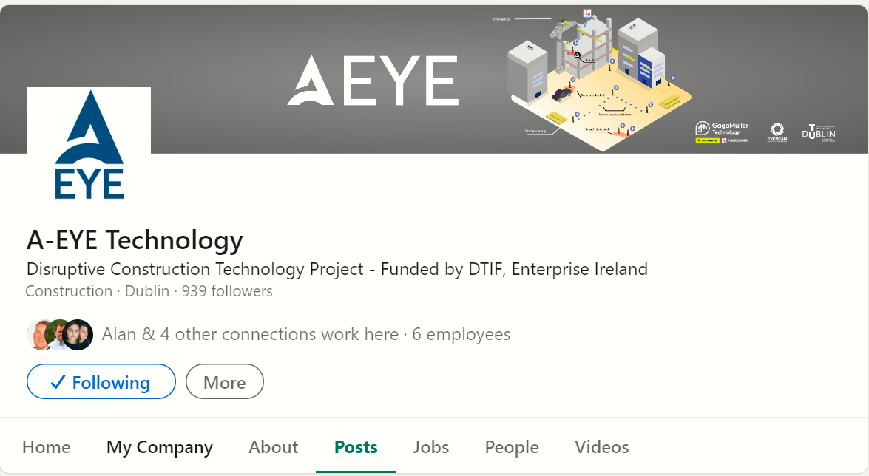
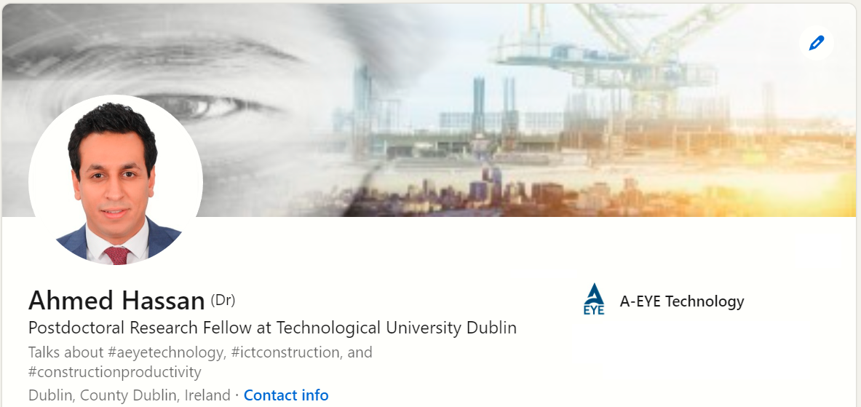
A-EYE Control Tower: AI-driven visibility platform to improve productivity on construction sites
Follow A-EYE & Connect with Ahmed
on LinkedIn
www.linkedin.com/company/a-eye-construction-technology/mycompany/
www.linkedin.com/in/ahmed-hassan-2b92a0166/

Slide 13
A-EYE Control Tower: AI-driven visibility platform to improve productivity on construction sites
Thank You

