Slide 1




Slide 2



Using technology to make informed buying decisions
Ciaran Brennan - CEO
LiveCosts.com

Slide 3
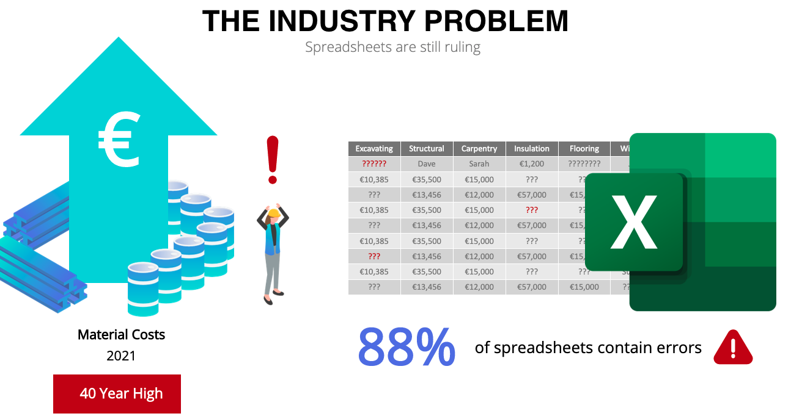
Using technology to make informed buying decisions
Ciaran Brennan - CEO
LiveCosts.com

Slide 4
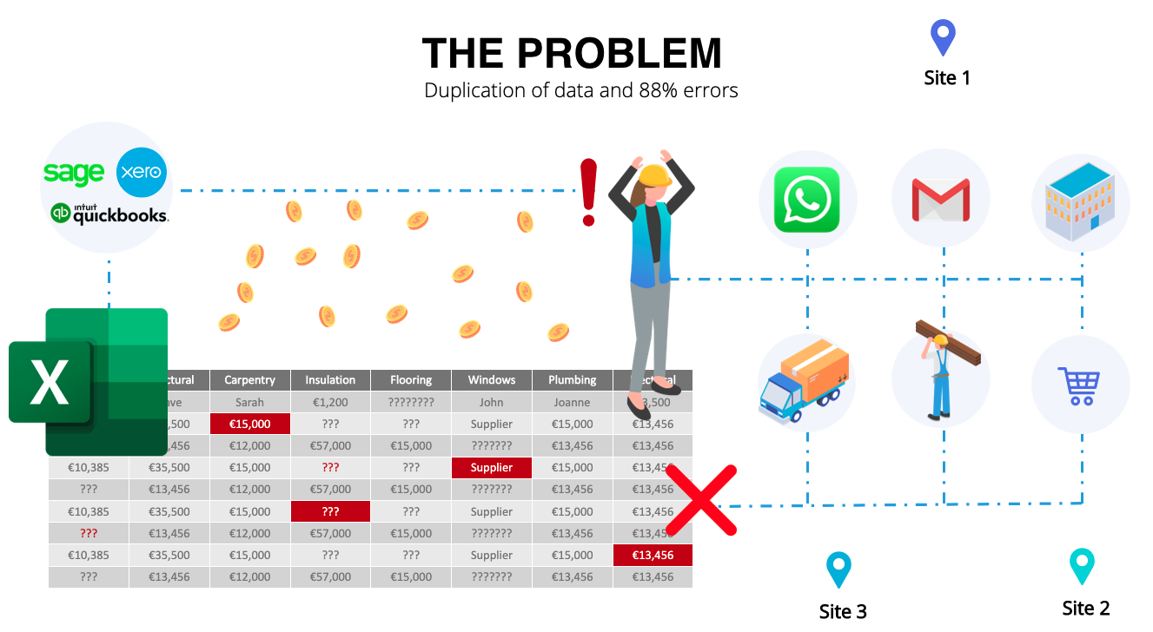
Using technology to make informed buying decisions
Ciaran Brennan - CEO
LiveCosts.com

Slide 5
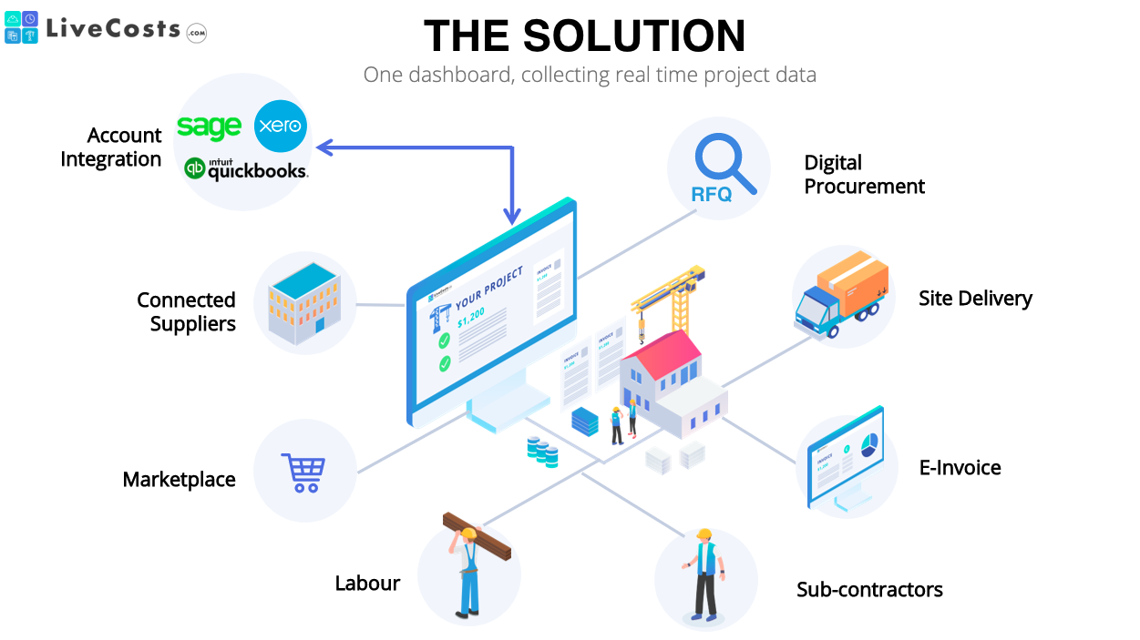
Using technology to make informed buying decisions
Ciaran Brennan - CEO
LiveCosts.com

Slide 6
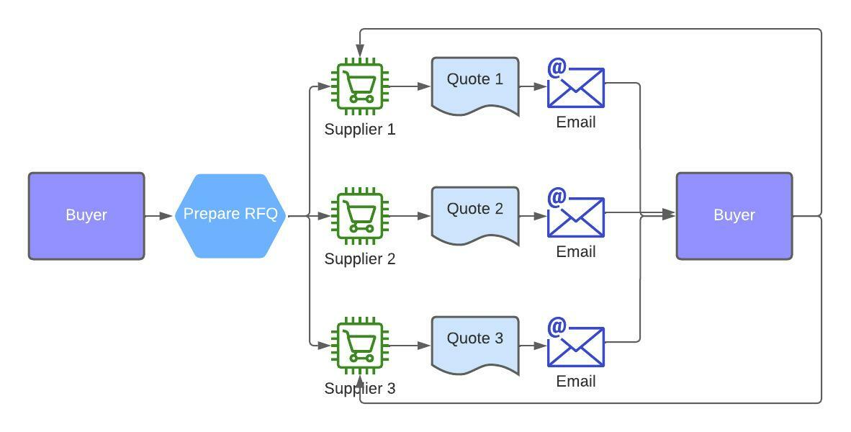
Using technology to make informed buying decisions
Ciaran Brennan - CEO
LiveCosts.com

Slide 7
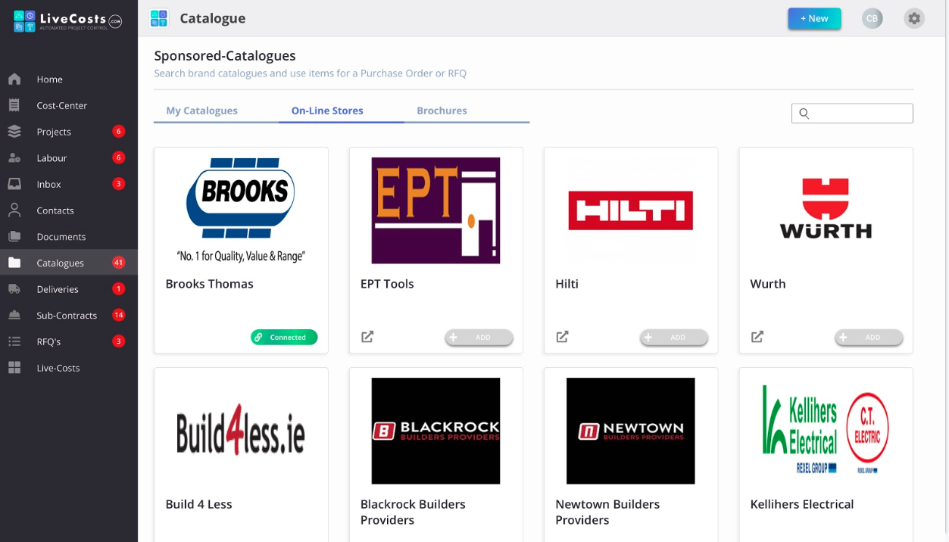
Using technology to make informed buying decisions

Slide 8
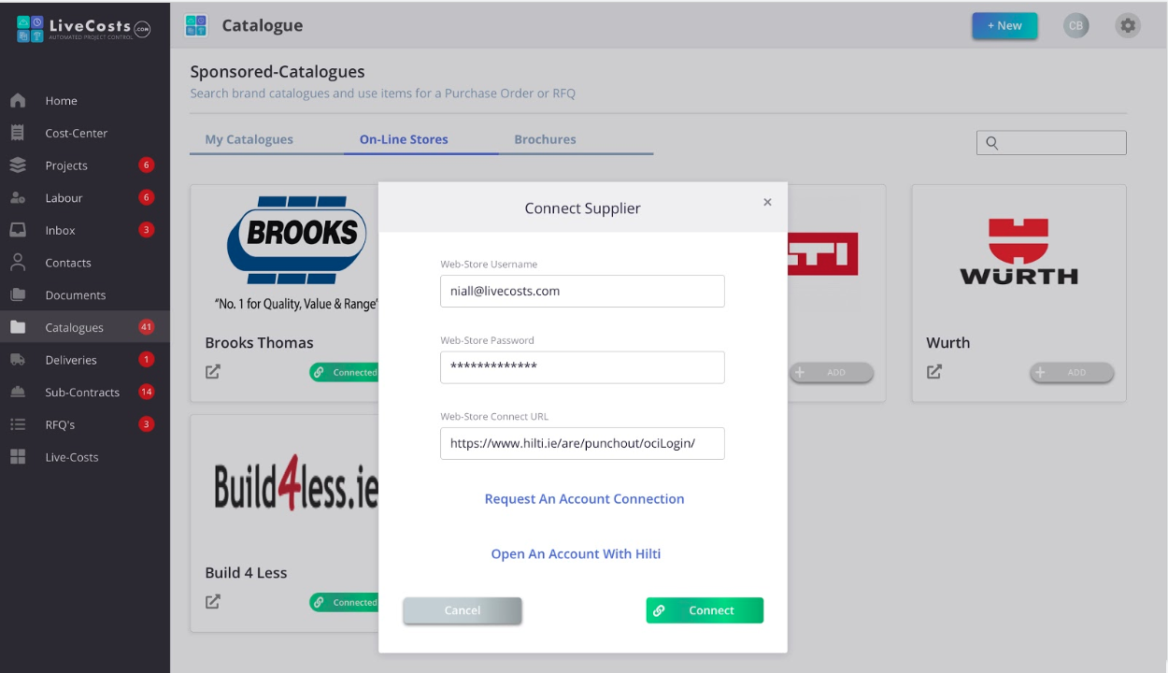
Using technology to make informed buying decisions

Slide 9
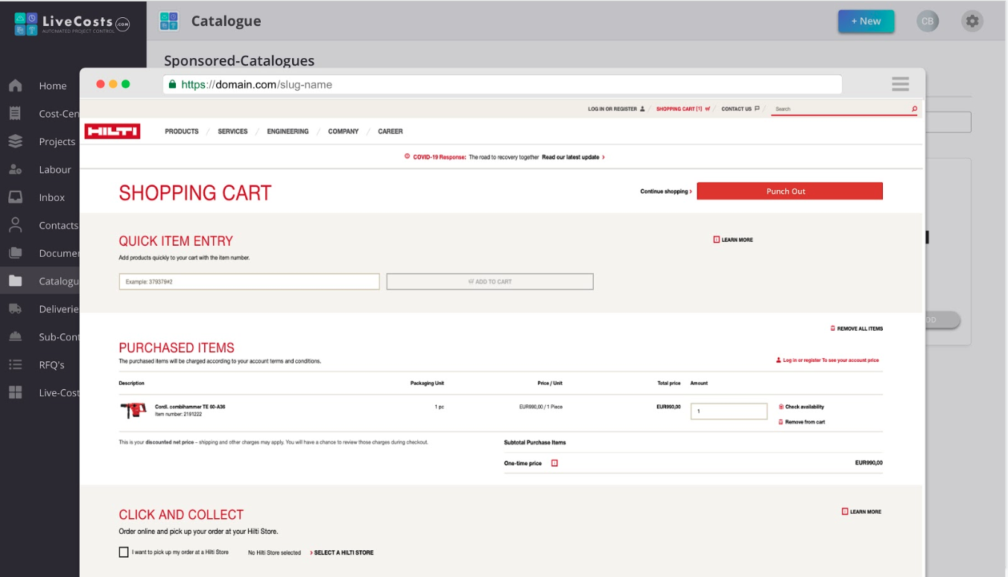
Using technology to make informed buying decisions

Slide 10
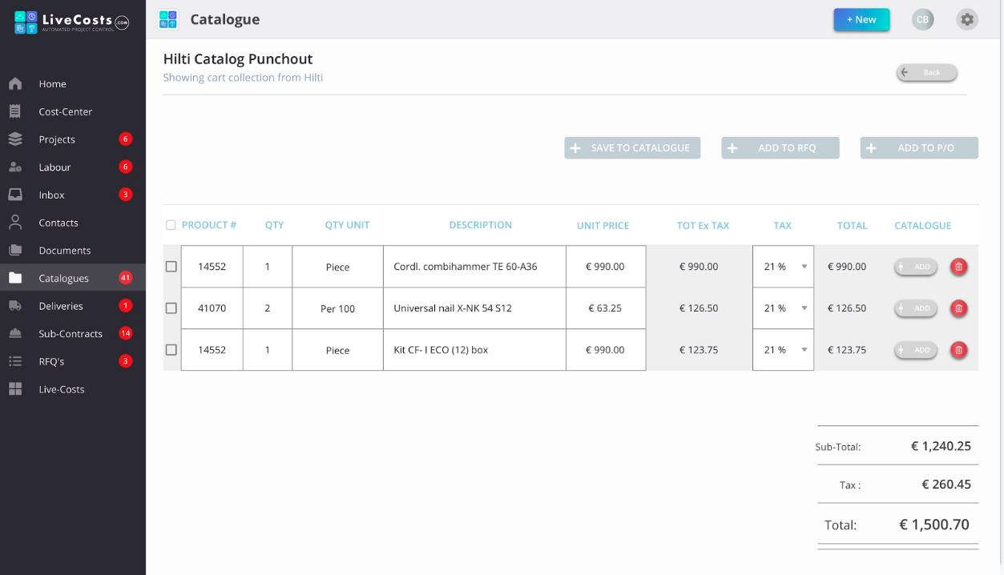
Using technology to make informed buying decisions

Slide 11
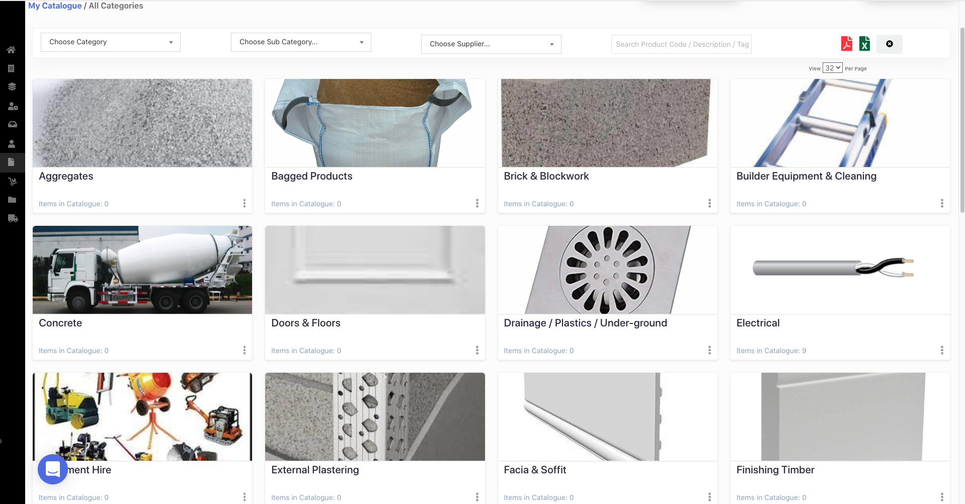
Using technology to make informed buying decisions

Slide 12
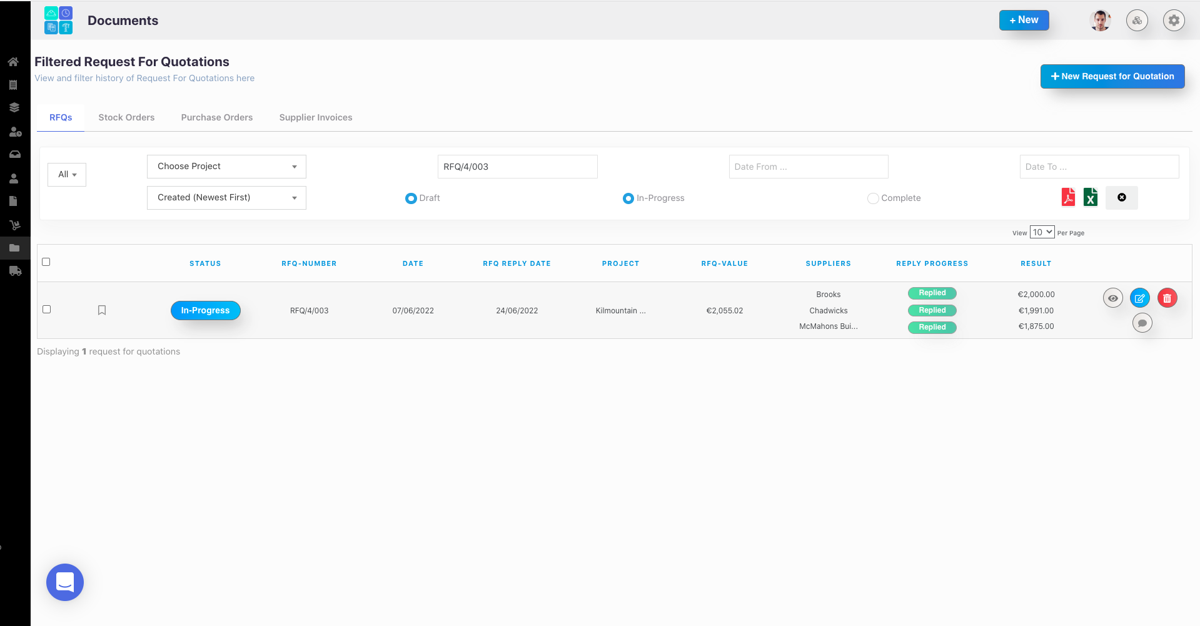
Using technology to make informed buying decisions

Slide 13

Using technology to make informed buying decisions

Slide 14

Using technology to make informed buying decisions
Ciaran Brennan - CEO
LiveCosts.com

Slide 15










Our sponsors
Platinum Sponsors
Gold Sponsors

