Slide 1

Experience of Planning Portal to
end of April 2022

Slide 2

Planning Authority Experience
Teresa Kiely
Administrative Officer
Planning Section
12th May 2022
Notes:
Working in the planning area of the Local Authority since 2002.

Slide 3
Pilot
Commenced 2021
Portal went live lunch time 21/12/21
First application submitted 22/12/21
Closed 24/12/21 for Xmas
Reopened 4/1/22
Notes:
The planning system itself is complex with a myriad of processes, scenarios and timelines so the development of a project by multiple system providers that takes account of a complex planning code together with the required integration of the developed system with 3 back-end planning systems (iPlan; APAS and Odyssey) and 8 * document management systems across 31 planning authorities brought significant added difficulties for the project. Never the less the pilot commenced in Tipperary County Council and Galway County Council on 21/12/2021 with applications submitted to both Planning Authorities on the morning of 22/12/2021 .

Slide 4
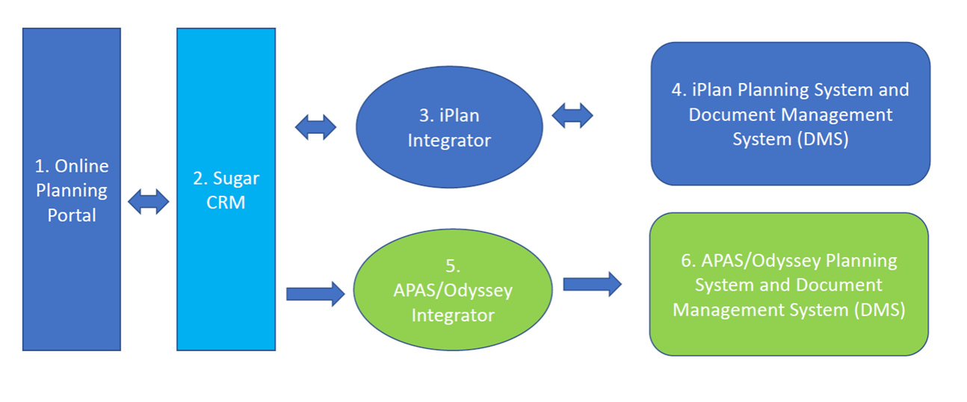
Planning Portal
System Overview
Https://planning.localgov.ie
Notes:
Both Tipperary and Galway use iplan to process planning applications, The document management system in Tipperary is idocs and Galway use reposit. Nationally currently there are three back office systems for processing applications and eight different document management systems

Slide 5
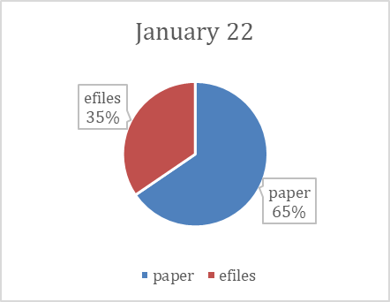
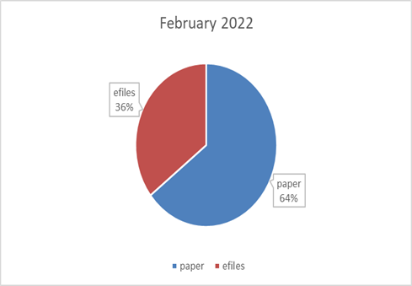
2022 year to date
Tipperary
Notes:
Same planning system, whether paper or efiles same questions on the statutory form, same requirements for maps/layouts/drawings/public notices. People working in the system (whether preparing applications for planning or processing applications) are generally familiar with the regulations covering same.

Slide 6
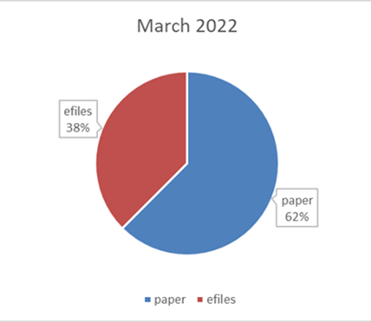
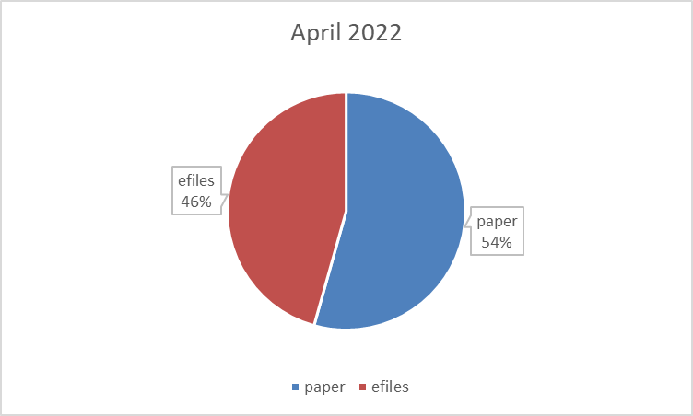
2022 year to date
Tipperary
Notes:
The volume of paper has been vastly reduced for planning applications, considering that paper files have a legal requirement for 6 copies, submit from home no need to drive to planning office or post office. Costs for both agents and planning offices reduced on account of this. Carbon footprint reduced also.

Slide 7
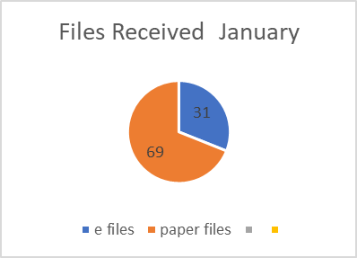
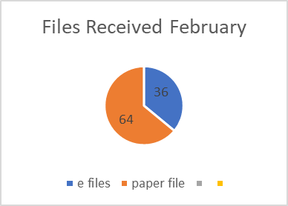
2022 year to date
Galway

Slide 8
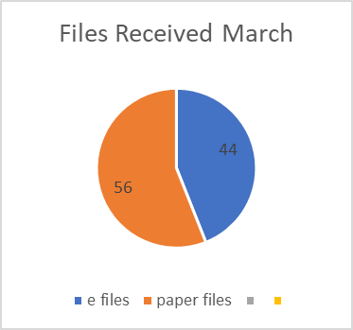
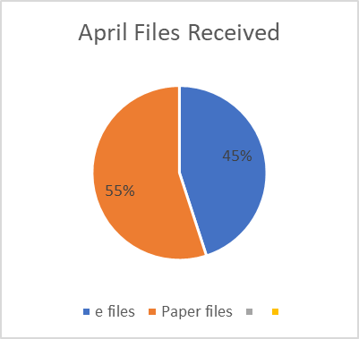
2022 year to date
Galway
Notes:
As you can see from the pie charts above the percentage of efiles is steadily increasing in both planning authorities,

Slide 9
Pilot
Agents are able to submit an application within an hour or
Agents can have a draft and build slowly then submit
Once file is processed and document inserted to document management system agent knows immediately
If in a position to do so agent can and have replied immediately.
Notes:
In Tipperary & Galway invalid files have been re-submitted on the same day, further information requests have been replied to on the same day. This would have been impossible with the paper/postal files.
There is no longer a postal period, documents are available within one working day for the public to view.

Slide 10
Pilot
E-Applications are available within one working day for the public to view
Increases the openness and transparency of the planning process
Same registration details will allow person to apply to any local authority
Currently just Tipperary and Galway but will be nationwide
Notes:
In Tipperary & Galway invalid files have been re-submitted on the same day, further information requests have been replied to on the same day. This would have been impossible with the paper/postal files.
There is no longer a postal period, documents are available within one working day for the public to view.

Slide 11
Next Steps
  Enable submissions to be made online
  Part 8 (Local Authority own development available on line)
  Both will be piloted in Tipperary and Galway
  Roll out nationally in three waves to other authorities using iplan
  Roll out to remaining authorities

Slide 12
???
Notes:
Thanks for your time and any questions

Slide 13
Tipperary County Council,
Civic Offices,
Limerick Road,
Nenagh,
Co. Tipperary
Tipperary County Council,
Civic Offices,
Emmet Street,
Clonmel,
Co. Tipperary
t 0818 06 5000
e Teresa.kiely
@tipperarycoco.ie
www.tipperarycoco.ie

